Slide 1
EDA Assignment 3 Part 1(A)
5420 Anomaly Detection, Fall 2020
- Harsh Dhanuka, hd2457
Article: Algorithmic Financial Trading with Deep Convolutional Neural Networks:
Time Series to Image Conversion Approach
- Omer Berat Sezer, Murat Ozbayoglu

Slide 2
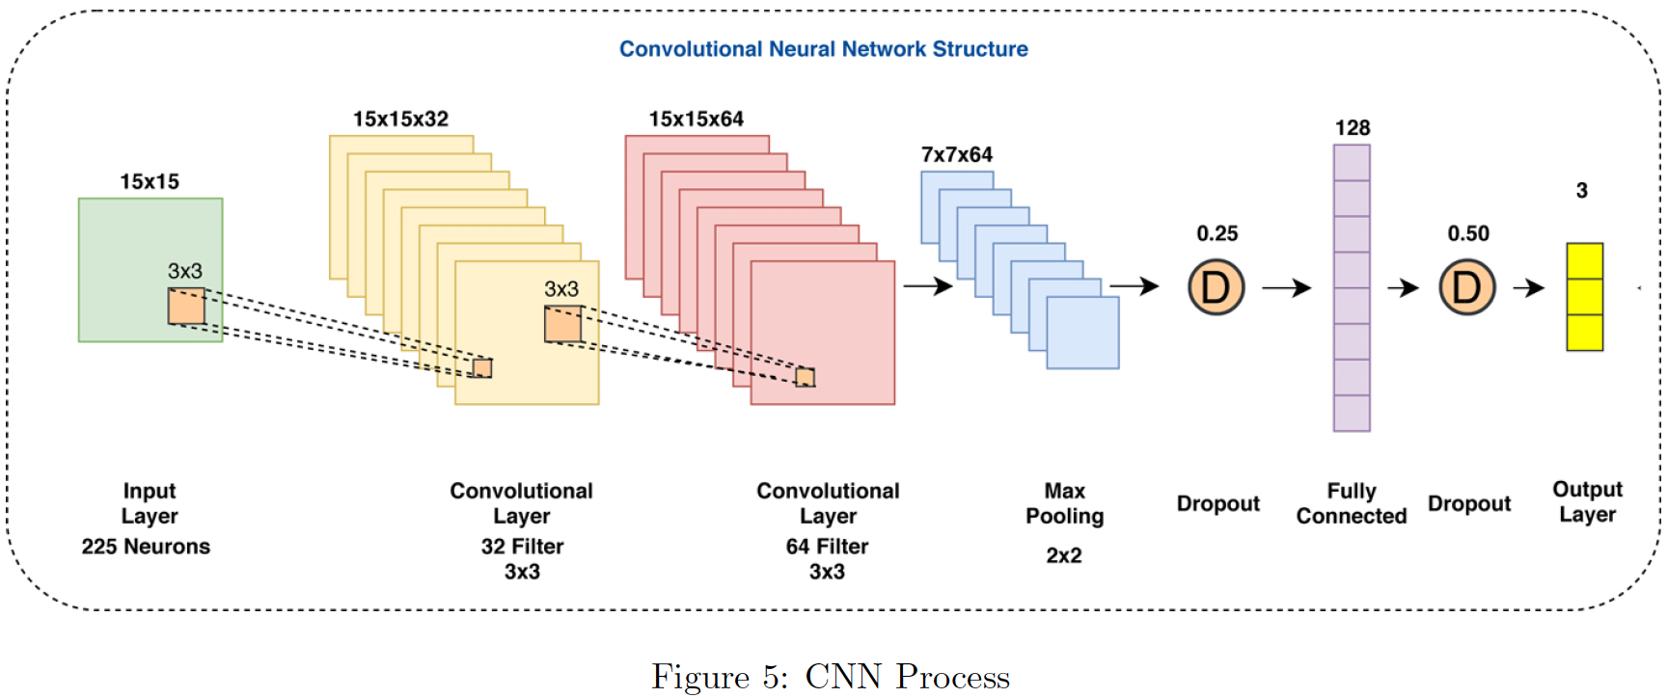
5420 Anomaly Detection, Fall 2020
- Harsh Dhanuka, hd2457
Key Takeaways
Deep Learning based prediction & classification models are emerging to be better than classical computational intelligence methods.
3
CNN – TA, best approach for Time Series Financial Stock Market Data Analytics:
Trading Systems
Prediction Models
It takes 2-D matrices/images as inputs, to develop an algorithmic trading system.
1
2
Common techniques are:
Recurrent Neural Networks (RNN)
Convolutional Neural Network (CNN)
Long short term memory
Transformed to one-dimensional vector
15 indicators with different parameter selections
Fully connected MLP

Slide 3
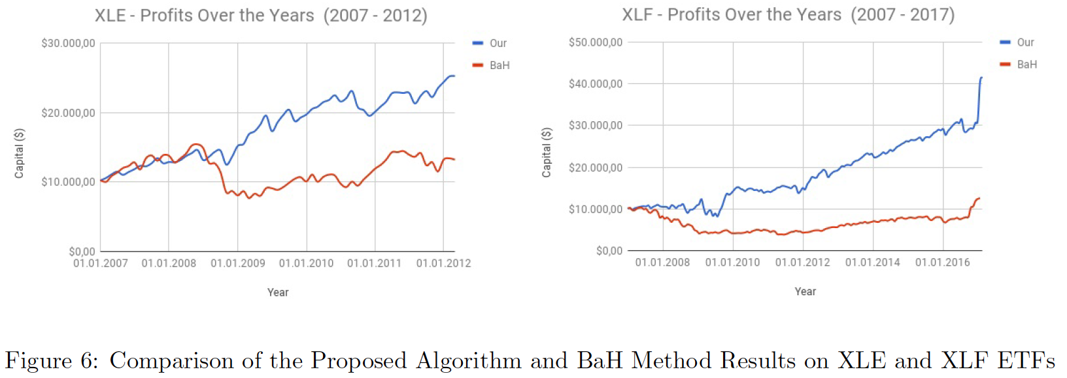
5420 Anomaly Detection, Fall 2020
- Harsh Dhanuka, hd2457
Key Takeaways
4
Performance Evaluation
Test / out-of-sample data
Computational Model Performance
Financial Evaluation
ETF Analysis
Statistical Significance Tests
5
Future Considerations
Optimize CNN structural parameters
Better data feed representation
Test long-short strategy for profits
The graph shows the proposed model's accumulation of the capital for selected ETFs. In each case, the model performance is compared against Buy & Hold during the corresponding period.

Slide 4
EDA Assignment 3 Part 1(b)
5420 Anomaly Detection, Fall 2020
- Harsh Dhanuka, hd2457

Slide 5



5420 Anomaly Detection, Fall 2020
- Harsh Dhanuka, hd2457
Approach to data
Stocks
S&P Global Inc. (SPGI)
Jan 2007 – Sep 2020
Facebook Inc. (FB)
May 2012 – Sep 2020
Apple Inc. (AAPL)
Jan 2007 – Sep 2020
Feature Engineering
Create OpenClose, OpenOpen, HighClose, CloseClose
Monthly prices, and Weekly, Monthly returns
Exploratory Data Analysis
Plot different metrics such as MACD, RSI, Kurtosis, Standard Deviation, Moving Averages, CCI, Bollinger Bands, Open-Close, Price, and Volume
Plot 13 graphs for each stock, check relation between the different metrics.
Eg. Low price results in high trade volume

Slide 6
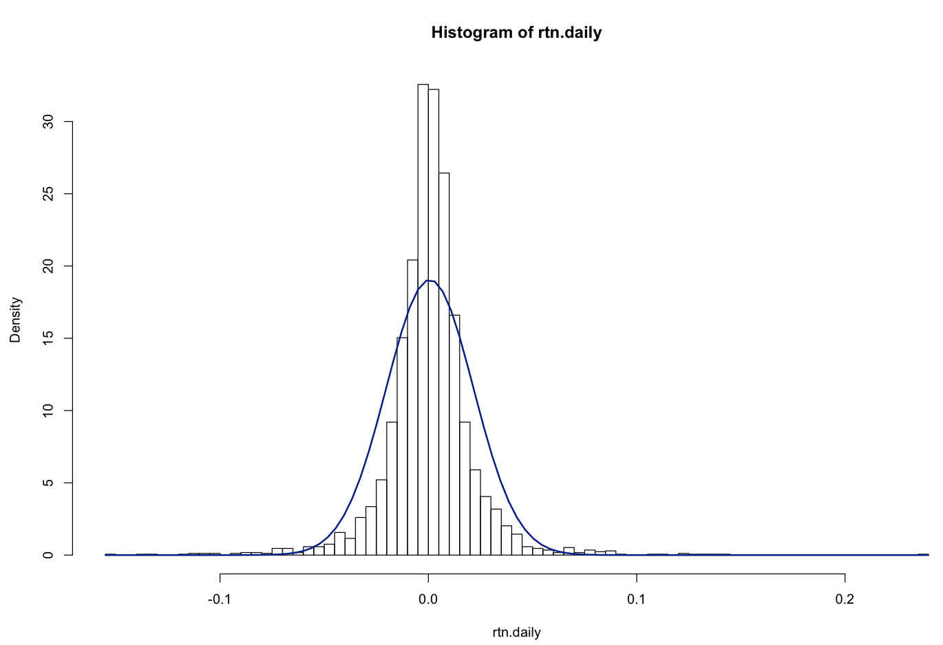
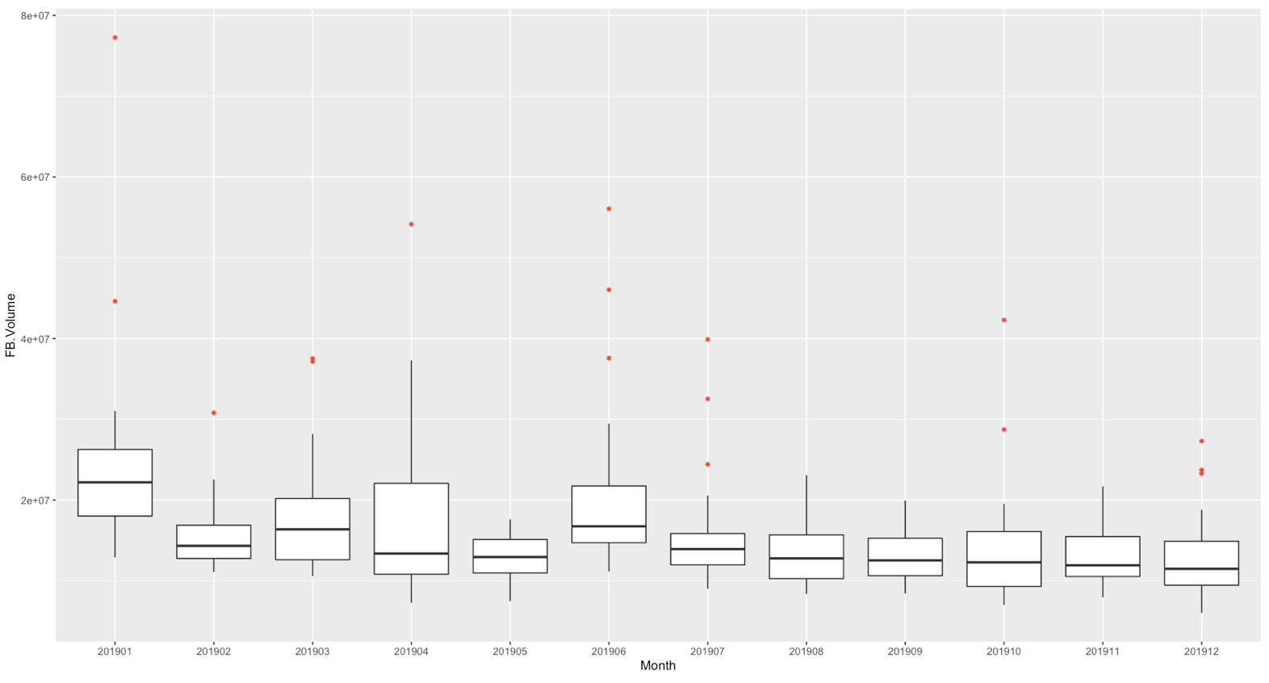
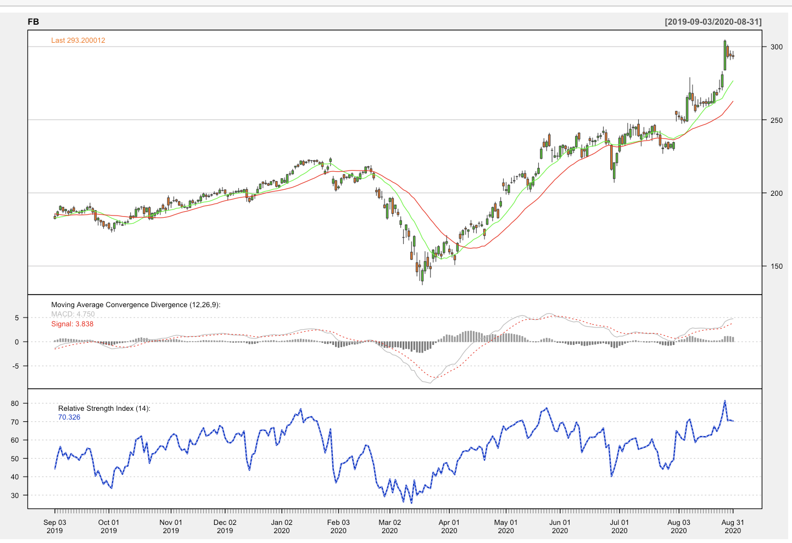
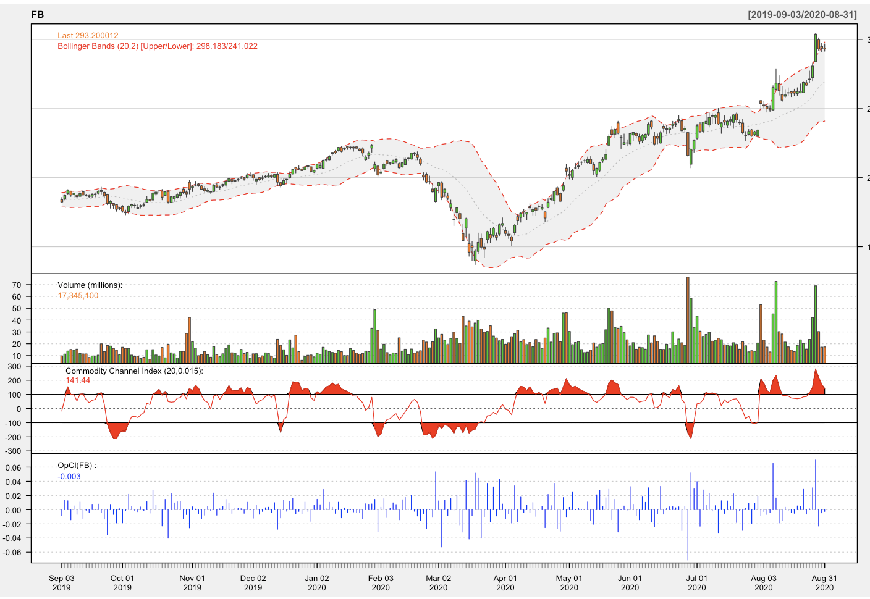
5420 Anomaly Detection, Fall 2020
- Harsh Dhanuka, hd2457
Exploratory Data Analysis
1
Daily Returns: Standard Deviation & Kurtosis; extreme fluctuations are highly likely if there is a high kurtosis (FB – 19.12)
2
Monthly Trade Volume: Evaluate outliers in the monthly volume, FB has many outliers in 2019 (red dots)
FB
Outliers
Standard (blue line)
3
Technical Analysis: Stock Price, Bollinger Bands, Volume, CCI, Open-Close (for FB)
4
MACD, RSI and Moving Averages (for FB)
Covid-19
(Mar-Apr 2020)
Covid-19
(Mar-Apr 2020)

Slide 7
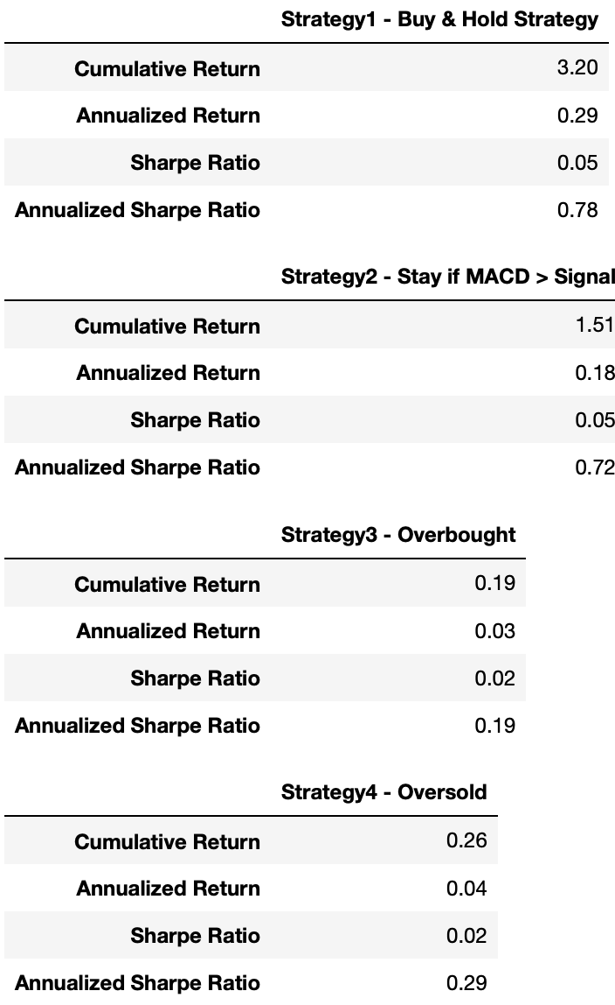
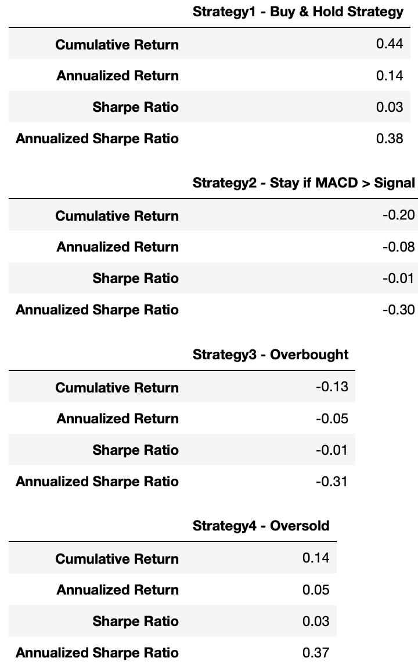
5420 Anomaly Detection, Fall 2020
- Harsh Dhanuka, hd2457
Strategy & Back-testing (in-sample & out-of-sample)
Strategies
1. Buy and Hold
2. Enter and stay as long as MACD>Signal
3. Overbought, enter and stay (RSI > 70)
4. Oversold, enter and stay (RSI < 30)
Use 80% time for in-sample, 20% for out-of-sample
For FB, in the in-sample test, I find that Strategy 1 and Strategy 2 are optimal, considering the Sharpe Ratio and Annualized Returns.
When verifying the observations with out-of-sample test, I find that ‘Buy and Hold’ is the best strategy for FB.
FB In-sample
FB Out-of-sample

Slide 8
5420 Anomaly Detection, Fall 2020
- Harsh Dhanuka, hd2457
Strategy & Back-testing (in-sample & out-of-sample)
Strategies
1. Buy and Hold
2. Enter and stay as long as MACD>Signal
3. Overbought, enter and stay (RSI > 70)
4. Oversold, enter and stay (RSI < 30)
Use 80% time for in-sample, 20% for out-of-sample
For FB, in the in-sample test, I find that Strategy 1 and Strategy 2 are optimal, considering the Sharpe Ratio and Annualized Returns.
When verifying the observations with out-of-sample test, I find that ‘Buy and Hold’ is the best strategy for FB.
FB In-sample
FB Out-of-sample

